Slide 1
Convolution Neural Networks
A Conceptual Introduction
Landon Buell
Nov 2019

Slide 2
Introduction
What does a “Convolutional Neural network” mean?

Slide 3
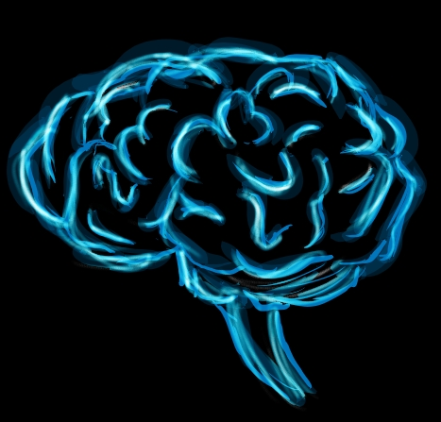
THE INTENT
Neural Networks are largely inspired from the brain (Sanderson)
Particularly the visual cortex
Using computers, can we mimic cognitive functions?

Slide 4
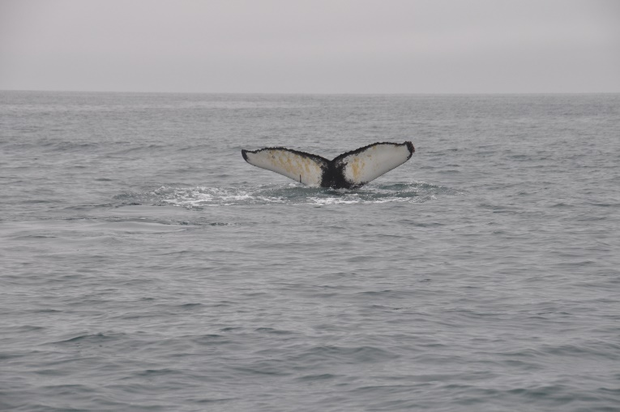
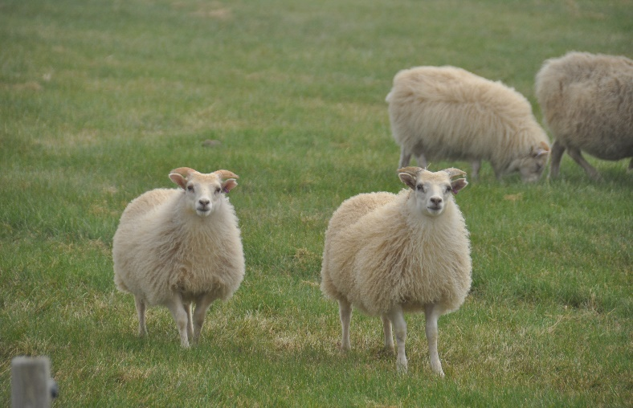
THE INTENT (Cont.)
CNNs have been used for visual recognition since the 1980’s (Geron)
Can computers be used to recognize qualities of images , audio, etc.?
I.e. which image has sheep? Which image has a whale?

Slide 5
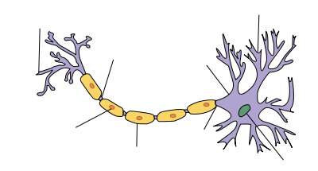
WHY “NEURAL”?
The basic unit of structure is a neuron
communicate by exchanging chemical signals
Function like mathematical operations
Take some input and return some output

Slide 6
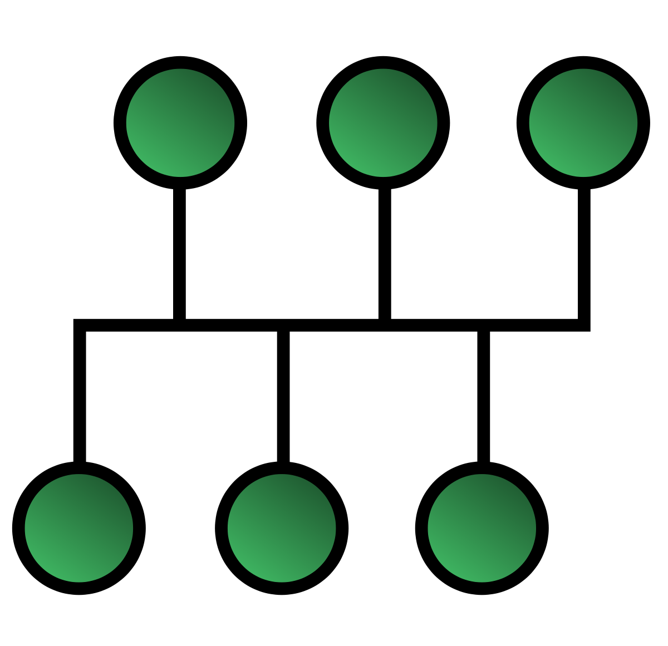
Why “Network”?
Much like the brain has collections of neurons, so too do CNN’s
It is a network of these neurons
This Photo by Unknown Author is licensed under CC BY-SA

Slide 7
WHY “CONVOLUTIONAL” ?
Attributed to layers of network
Multiple layer exist and interact
This combination produces a final output

Slide 8
How Does it Work?
What can we do with them?

Slide 9
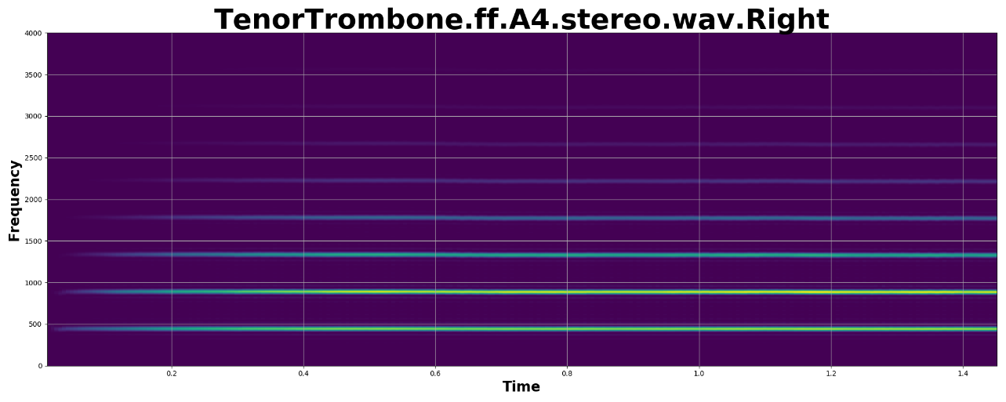
INPUT FOR A CONVOLUTION NERUAL NETWORK
We build CNNs as a very complicated connection of ‘functions’
Functions require inputs to produce outputs
Each Pixel in an image or sample in a waveform

Slide 10


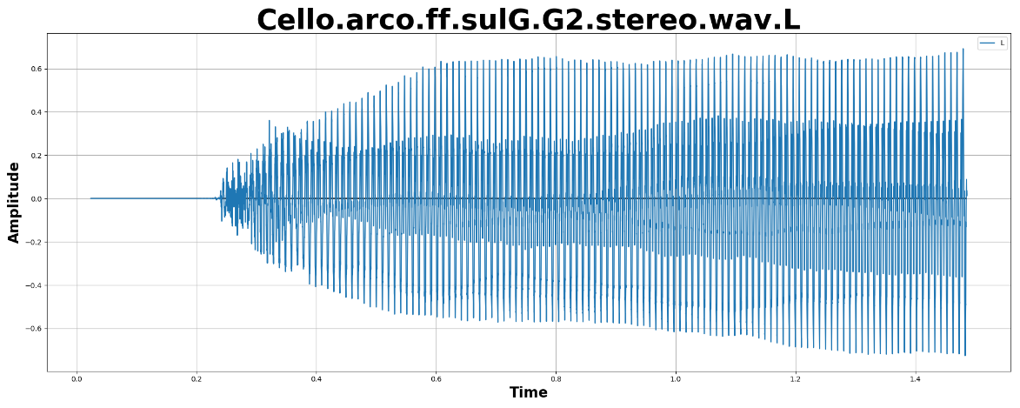
DATA INPUT – IMAGES & AUDIO
Most commonly, they tend to take the form of an array
Most types of inputs can be converted to arrays
The Images to the left can all be represented as a list of floats

Slide 11
LAYERS OF NEURONS
We can take an array and use each index as an input to the first “layer” of neurons
Called Input Neurons
Each neuron can also have an associated weighting function
Scales output value
Determines “strength” or “importance” of input
The collective output of the Input Layer can be fed into the next layer
This process repeats for N layers until the CNN produces a final result.
Hence the “Network” of neurons

Slide 12

MATHEMATICAL TREATMENT
Matrix-Vector Equation
$${\overset{⃑}{L}}_{N+1}=\hat{W}{\overset{⃑}{L}}_{N}$$
Written out:
$$\left[\begin{matrix}x_{0}^{N+1} \\ ⋮ \\ x_{m}^{N+1}\end{matrix}\right]=\left[\begin{matrix}w_{0}^{0} \\ ⋮ \\ w_{0}^{k}\end{matrix}\begin{matrix}w_{1}^{0} \\ ⋮ \\ w_{1}^{k}\end{matrix}\begin{matrix}… \\ ⋱ \\ …\end{matrix}\begin{matrix}w_{m}^{n} \\ ⋮ \\ w_{m}^{k}\end{matrix}\right]\left[\begin{matrix}y_{0}^{N} \\ ⋮ \\ y_{m}^{N}\end{matrix}\right]$$
The output of the N^{th} layer can be arranged into a column vector
The weights are arranged into a matrix
The resulting vector is the input for N+1th layer
A biasing function can then be applied to entire operation if needed

Slide 13
Uses of CNNs
Demonstrated with a practical example

Slide 14

IMAGE RECOGNITION
Most common use for CNNs is Image recognition (Geron)
Also used for voice recognition, and language processing

Slide 15




AN EXAMPLE – IMAGE CLASSIFIER
MNIST has a database of 70,000 handwritten figures
Each figure is 28 x 28-pixel image
We can use this as a quick practical example

Slide 16
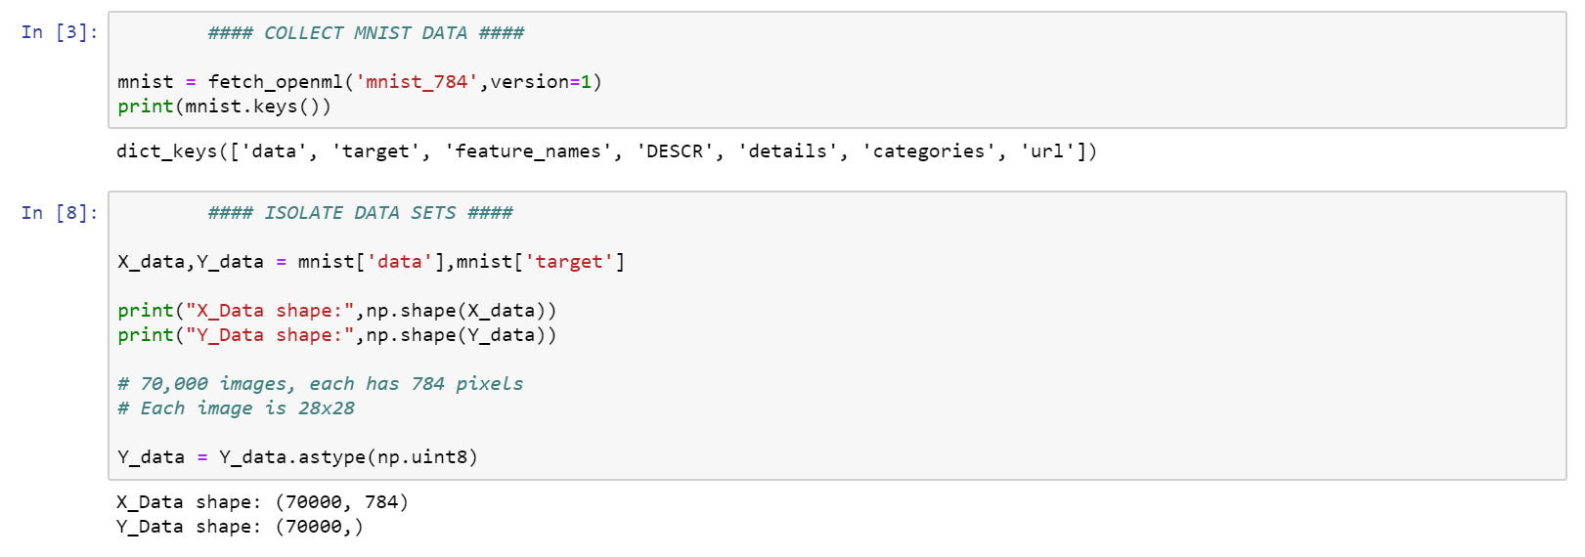
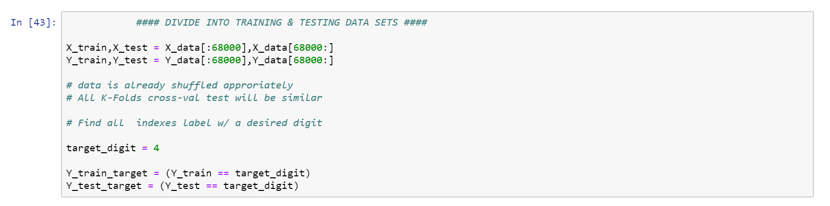
ORGANIZING A DATASET
MNIST Data is loaded into Python
Separated into training & testing datasets
Data is labeled as needed
Program Dapated from Aurelien Geron, “Hands On Machine Learning with Scikit-Learn & Tensorflow”

Slide 17
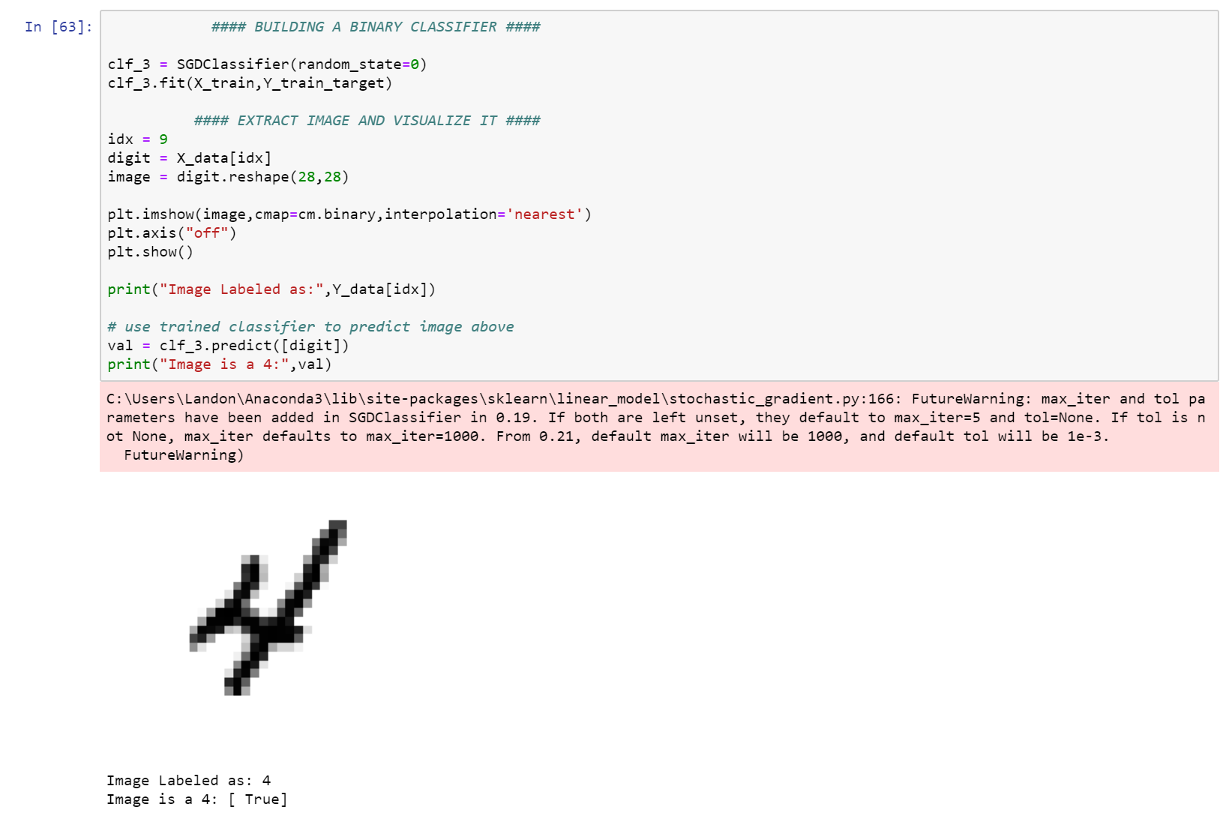
TRAINING A BINARY CLASSIFIER
Train Binary Classifier
4 vs. Not 4 as an example
Array of Boolean labels for dataset
Use Stochastic Gradient Descent Classification Method
Each Pixel is an input

Slide 18
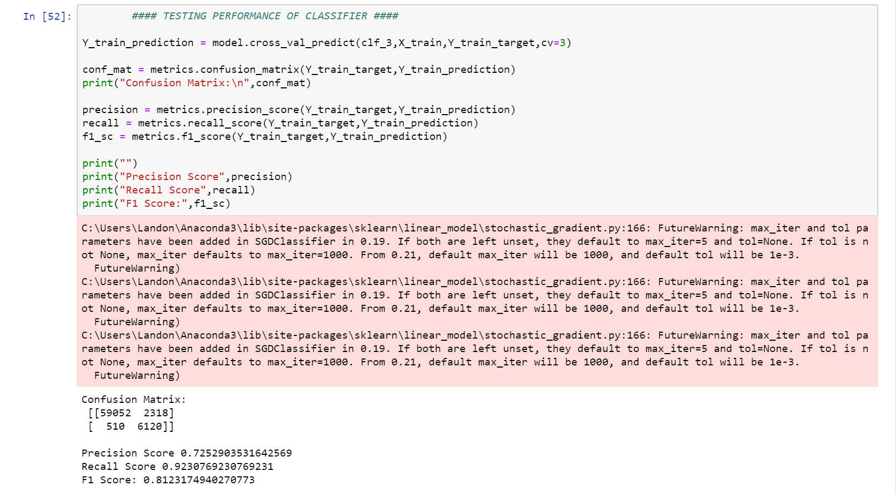

TESTING THE BINARY CLASSIFIER
K-Folds Cross Validation
Use A Confusion Matrix
$$\left[\begin{matrix}\left(TN\right) & (FP) \\ (FN) & (TP)\end{matrix}\right]$$
Test other metrics
Precision, Recall, F1 Score

Slide 19

NOTES ON METRICS
Precision – Correct Identification of Class
$P= \frac{TP}{TP+FP}$
Recall – Percentage of class identified
$R= \frac{TP}{TP+TN}$
F1 Score – Harmonic Mean of Precision & Recall
$F_{1}=\frac{P×R}{P+R}$

Slide 20
NOTES ON STOCHASTIC GRADIENT DESCENT
Mathematical procedure to find local minima of a function
Continually iterate until a local minimum is found
Modify parameters based properties of iteration
“Stochastic” implies randomness
Works like a form of linear- regression

Slide 21
CITATIONS
Sanderson, Grant. But What Is A Neural Network? 3Blue1Brown, www.3blue1brown.com/neural-networks.
“Convolution Neural Networks.” Hands-on Machine Learning with Scikit-Learn and TensorFlow Concepts, Tools, and Techniques to Build Intelligent Systems, by Aurélien Géron, O'Reilly, 2017, pp. 361–386.

